Slide 1
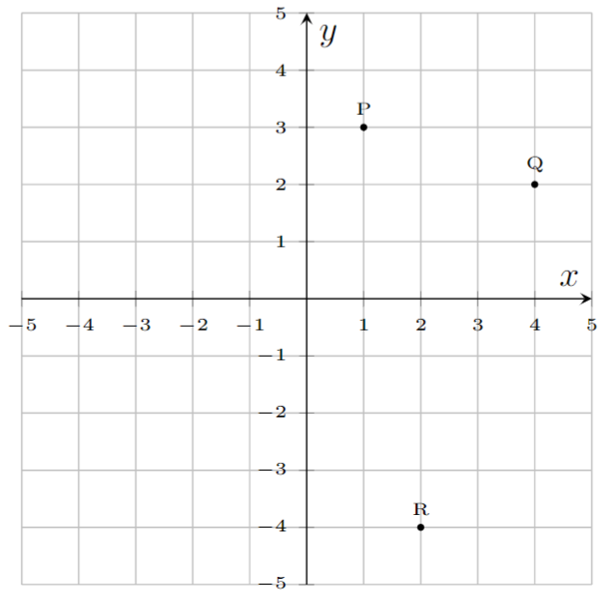
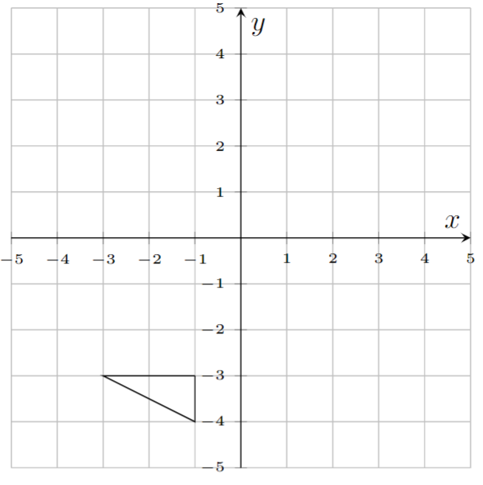



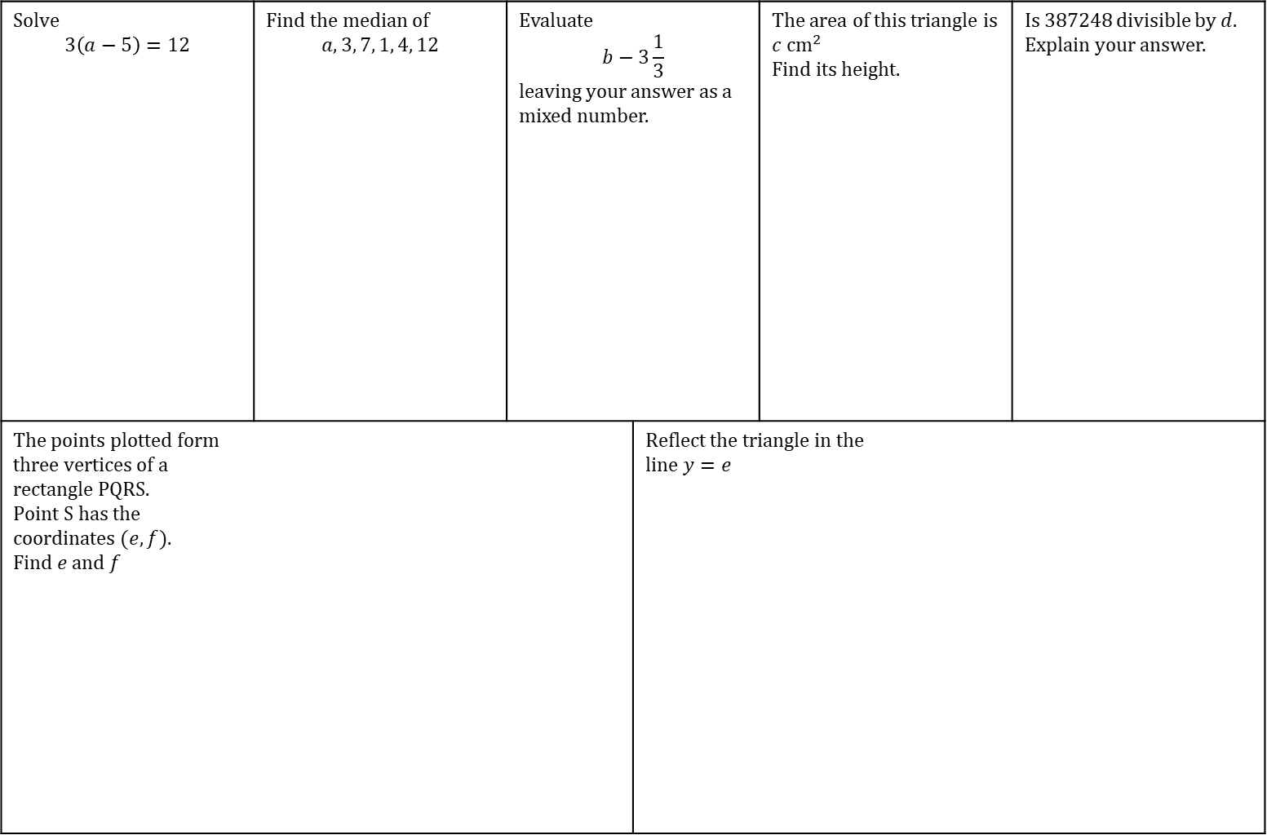





TASK
Answer chain.
Date:
Solve $$3\left(a−5\right)=12$$ | Find the median of $$a, 3, 7, 1, 4, 12$$ | Evaluate $$b−3\frac{1}{3}$$ leaving your answer as a mixed number. |  | The area of this triangle is $c {cm}^{2}$ Find its height. |  | Is 387248 divisible by $d$. Explain your answer.
The points plotted form three vertices of a rectangle PQRS. Point S has the coordinates $(e,f)$. Find $e$ and $f$ |  |  | Reflect the triangle in the line $y=e$
$$d \text{cm}$$
$$\frac{13}{24}\text{cm}$$
$$a=$$
$$b=$$
$$c=$$
$$d=$$
$$e=$$
$$f=$$

Slide 2
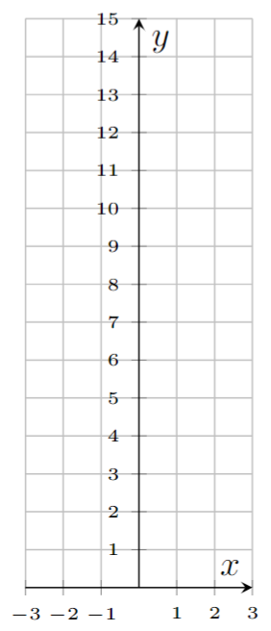


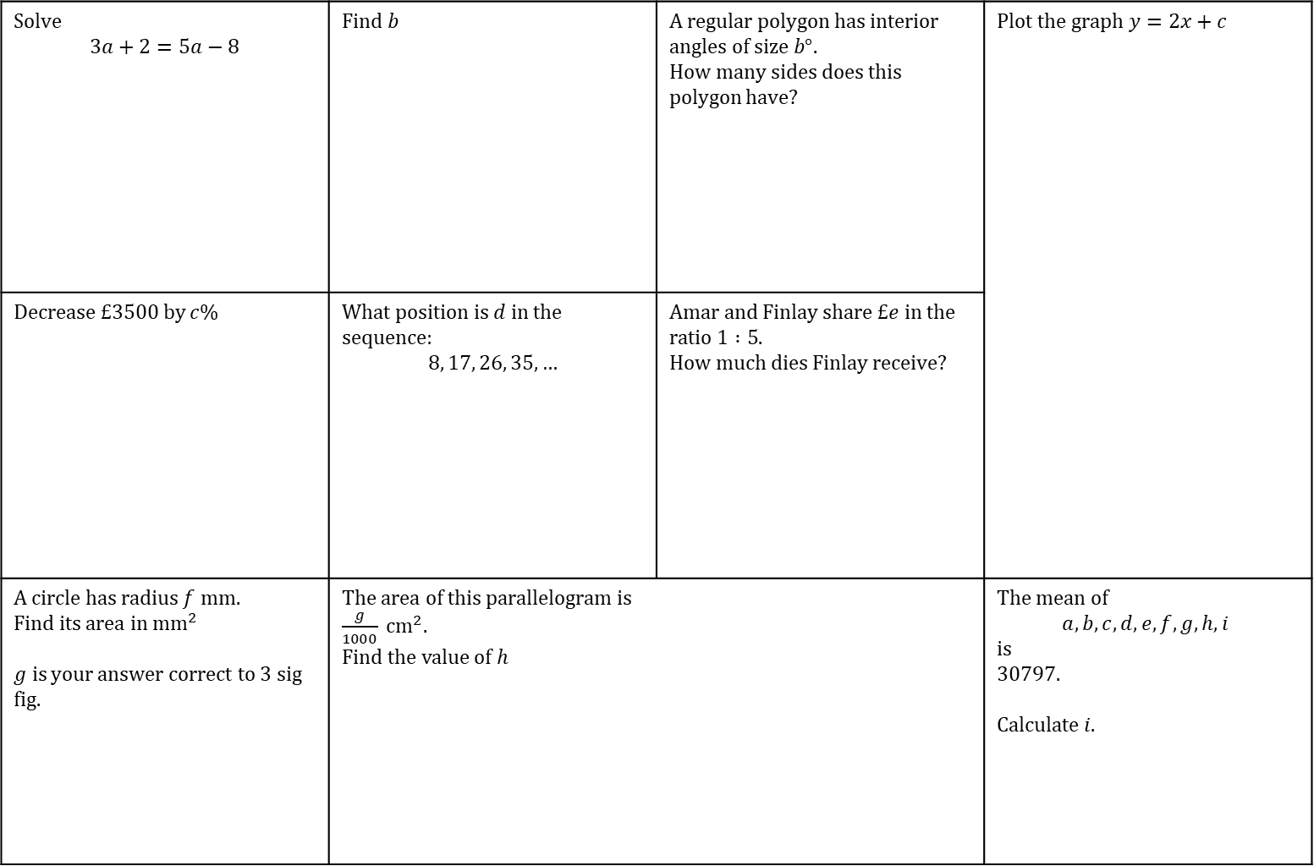












TASK
Answer chain.
Date:
Solve $$3a+2=5a−8$$ | Find $b$ | A regular polygon has interior angles of size $b°.$ How many sides does this polygon have? | Plot the graph $y=2x+c$
Decrease £3500 by $c$% | What position is $d$ in the sequence: $$8, 17, 26, 35, …$$ | Amar and Finlay share £$e$ in the ratio $1 :5$. How much dies Finlay receive?
A circle has radius $f$ mm. Find its area in ${\text{mm}}^{2}$ $g is$your answer correct to 3 sig fig. | The area of this parallelogram is $\frac{g}{1000} {\text{cm}}^{2}$. Find the value of $h$ |  | The mean of $$a, b, c, d, e, f, g, h, i$$ is 30797. Calculate $i.$
$$x$$ | $$−2$$ | $$−1$$ | $$0$$ | $$1$$ | $$2$$
$$y$$
$$85°$$
$$b°$$
$$11a°$$
$$a=$$
$$b=$$
$$c=$$
$$d=$$
$$e=$$
$$f=$$
13 cm
25 cm
$7h$ cm
$$g=$$
$$h=$$
$$i=$$

